Slide 1
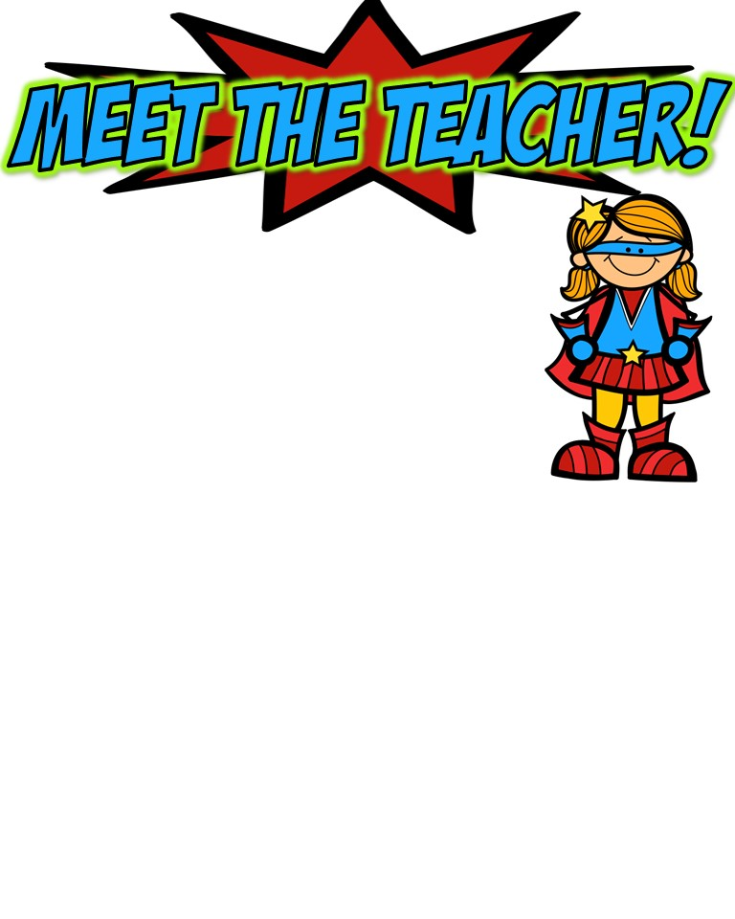
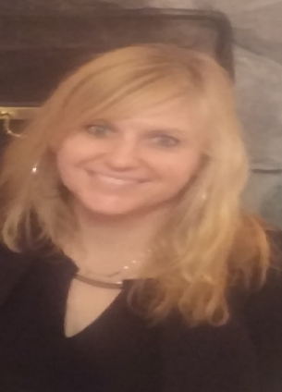
The basics!
Hi! My Name is Sarah Hamann! I live in Fowlerville with my wonderful husband, Duane and my 4 children. My oldest daughter, Rose, is 19 and attends Kendall College of Art and Design in Grand Rapids. My son, Patrick, is 16 and a junior at Stevenson High School. My identical twin 15 year old daughters, Maria and Maureen, are in 10th grade at Stevenson also. This is my 30th year of teaching and I am excited to make this my best year yet!
My childhood!
I spent the majority of my school years in Dearborn and graduated from Dearborn High School, Class of ‘85! I did live in Salisbury, Maryland where I went to school for kindergarten and 1st grade. As a child, much of my time was spent at the dance studio taking ballet from my mother, as well as tap and jazz. I was also on track and swim teams for many years.
My Favorites!
My education!
Food: Salad (Especially from Panera)
Movie: Wonder
Book: The Lord of the Rings series
Color: Red and certain shades of blue
Drink: Panera Hazelnut Coffee
Season: Fall
Sports: Baseball
Fast Food: Panera (Well, it’s not exactly fast food. ☺)
Music: 70’s, 80’s and Elvis
Store: Target and Costco
Dessert: Tiramisu
Candy: Twizzlers
Restaurant: Bravo! And…Panera
Flower: Rose
In May of 1989, I graduated with my Elementary Education degree from the University of Michigan. After teaching for 6 years, I received my Masters Degree in Special Education, with a focus in Learning Disabilities also from the U of M.
Contact me!
Email: shamann@livoniapublicschools.org
School Phone Number: (734) 744-2795

